Slide 1

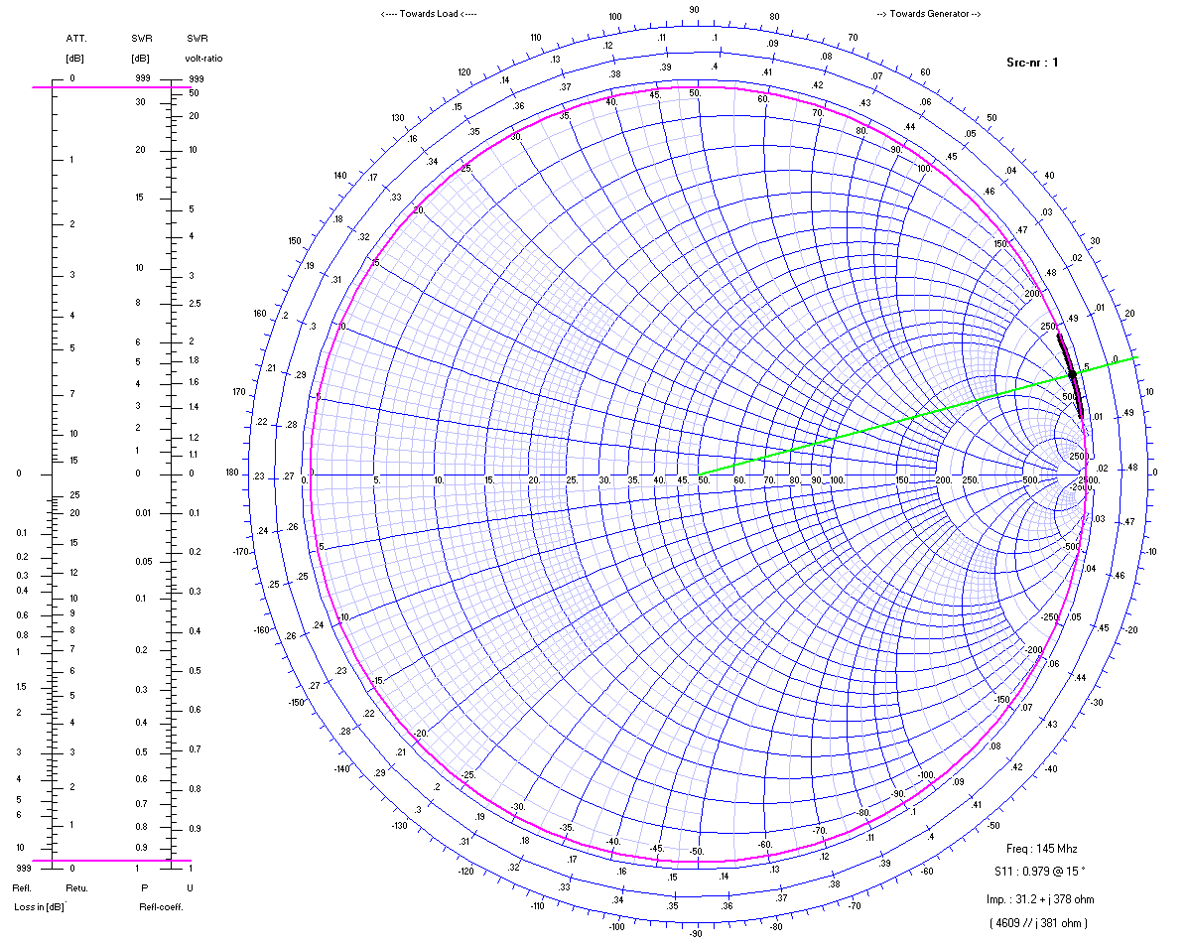
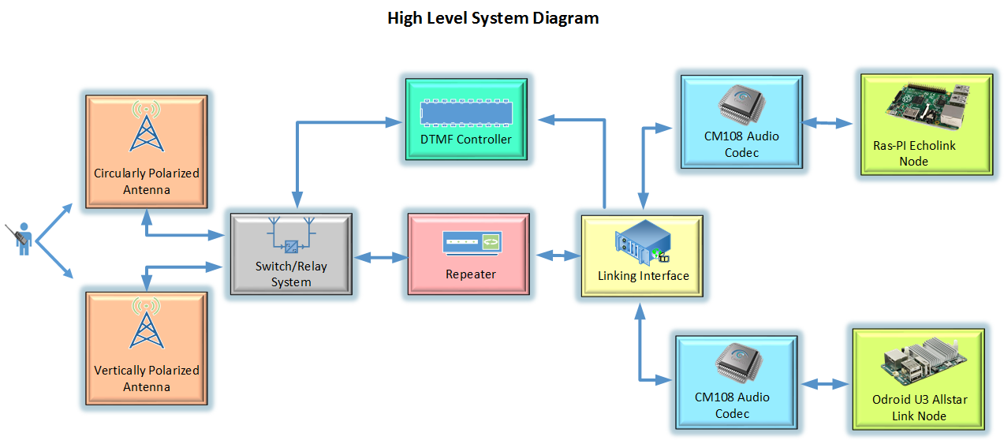
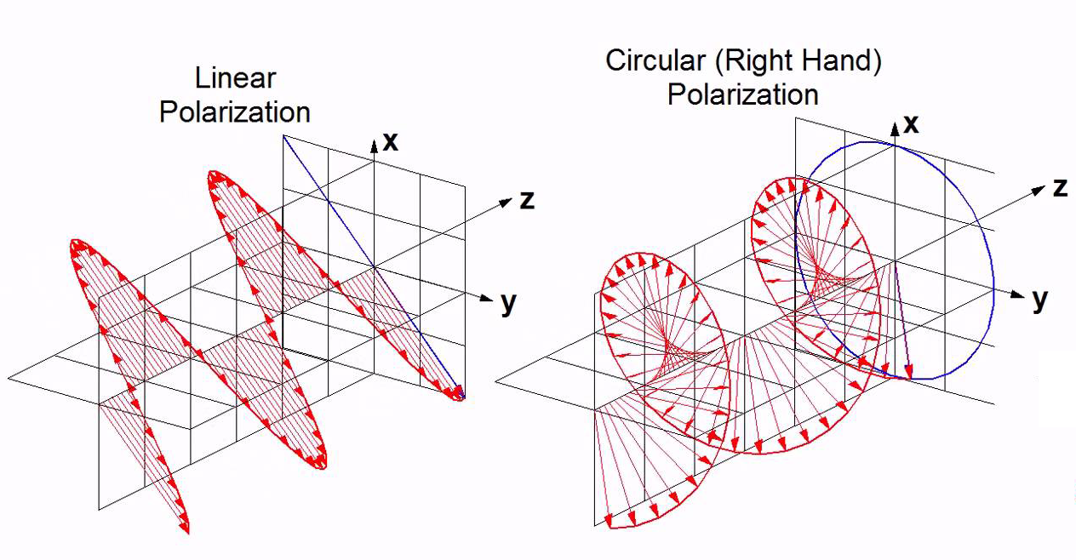
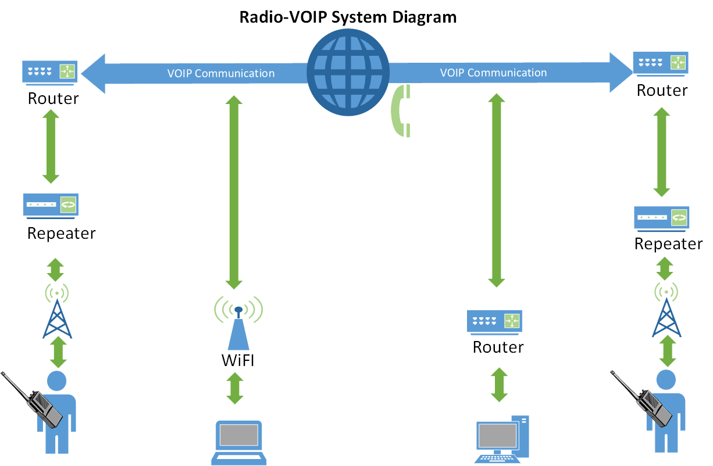
UCSC ARC CPOL Antenna
Kevin Helms, Tim Bodkin, Luis Ceja, Chris Tatosian
Abstract
Overview
Analysis
UC Santa Cruz currently utilizes an amateur radio repeater which listens for low power signals, beginning with PL tones, at 144.710 MHz and immediately rebroadcasts, or ‘repeats,’ them at much higher power on a 145.310 Mhz. The location of UCSC and the surrounding geography present a problem with wireless communication and due to the mountainous terrain, some coverage areas are shadowed by hills and are subject to multipath interference.
We currently have a 7/8 wave vertically polarized antenna on the roof of Baskin Engineering. Vertical polarization, meaning the electric field vectors of the propagating wave, are perpendicular to the
Earth, and have a higher likelihood of being degraded due to refraction and absorption. By the time the traveling wave reaches our repeater it may be tilted as it travels over the earth or bounced off objects or hills. By super position this may result in a horizontally polarized wave-front which would cause a loss of 20 dB or more in received power, or multipath interference due to waves being out of phase and cancelling out.
Our goal is to create an antenna which radiates with circular polarization. This mitigates the polarization mismatch and results in only 3 dB of loss regardless of how the linear antennas are oriented and is much lower probability of being degraded due to absorption and refraction compared to linearly polarized waves.
By reducing multipath interference, the circularly polarized antenna design will increase the local reach, and dependability of the UCSC amateur radio repeater. Additionally, two separate RoIP nodes will be implemented which will interface with the repeater, thus providing world wide connectivity with the amateur radio community. RoIP, which stands for “Radio over Internet Protocol” is similar to VoIP, and in fact uses many of the same protocols as services such as skype. By implementing two nodes which use 2 different protocols this would allow the repeater to communicate with people on multiple networks, namely, Echolink, and Allstar Link.
Once a user activates an RoIP node, the user must then key in the number of the node they would like to connect with. Depending on which network is being utilized, the destination node does not necessarily have to be another repeater, or radio. In addition to repeater, and transceiver nodes, the Echolink network for example, allows users to use their mobile phones, and PCs to connect to the network.
An Audio linking interface serves as the central hub for the summing, and distribution of all audio, and control signals to and from the repeater. Due to the system’s necessity of having multiple recipients of the audio signal from the repeater, as well as a need for control logic between these devices, having a single point in the system to facilitate the interaction served as a way to simplify this part of the system. The DTMF activated microcontroller will serve as a means to control the switching of antennas from the field. This module is responsible for decoding incoming DTMF sequences, acknowledging a command to switch antennas, and preventing the repeater from transmitting while switching.
In order to evaluate the effectiveness of the circularly polarized antenna versus the linear antenna in real time, a system was required that would allow for rapid switching between the two antennas. This need dictated the creation of an antenna switching system. This system is responsible for regulating the power provided to pair of relays which connect both antennas to the repeater.
Once fully integrated, the system, from a high level perspective will function such that a person in the field will have the ability to communicate with the UCSC repeater through their handheld, mobile, or stationary transceiver. Both the antenna switching circuit, and the RoIP nodes are designed to be controlled wirelessly via DTMF protocol which is sent from the keypad of the user’s transceiver. Using predetermined DTMF sequences, the user will have the ability to choose which antenna they would like to use, as well as activate, and operate the RoIP nodes, thus giving them the ability to communicate with other nodes, both amateur radio nodes, as well as non-radio nodes.
The antenna design was based off of work done by WA7X due to the simplicity of the design, and the availability of materials. With the specifications of the design being similar gain as the current antenna, and a high axial ratio, a good starting point was a quarter wave vertical dipole connected to a half wave loop. Maximum gain was achieved in the horizontal, a desired result, though it is much less than the current antenna at 2.16 dB_{i}. The axial ratio of this initial design was between .7 and 1.0 .
Approach
Results
Our approach is to design, characterize, and implement a circularly polarized antenna to increase the UCSC AC6P Repeater range and to mitigate multipath interference in troublesome coverage areas. The antenna will be interfaced with the repeater via DTMF protocol, allowing for smooth switching between the current linearly polarized antenna and the circularly polarized antenna wirelessly, from a portable radio. Echolink and All-Star Link nodes will be integrated into the current system with our
DTMF controller, allowing worldwide access to our repeater.
A prototype antenna was constructed using ¼” copper pipe. From here, there were design challenges in making the antenna structurally stable as well as taking accurate measurements. The initial measurements seemed inaccurate, and was later confirmed to be due to calibration and the way the antenna was being fed the signal. Since the initial measurements seemed to disagree with simulation, a simple quarter wave dipole was constructed so that more accurate measurements could be made on a simpler antenna. In doing a so a more legitimate, stable, feedpoint was constructed. Upon confirmation with simulation, the dipole was disassembled and the feedpoint was transferred to the CPol antenna.
We decided to implement the All Star Link node using the Odroid U3. In order to run smoothly, All Star Link requires at least 1.2 GHz of processing power, which the Odroid U3 is more than capable of running, at 1.7GHz. The Odroid U3 also comes with a GPIO board that includes the Atmega 328, the same microcontroller we are using for the DTMF controller. By using the Odroid U3 with the GPIO board, we have the possibility of merging the DTMF Controller onto the same board as the All Star Link. The Odroid also uses the same usb audio codec, the CM 108 chipset. This is configured through the chan_usb.c file compiled under Asterisk.
Conclusion
Acknowledgments
This project is not yet concluded… (But it will be by the time this poster is presented)
Stephen Petersen (AC6P) – Project Manager
Jeff Bertalotto – Project Manager
Logos of other financial assistance can go here as well (if logo exist)

